Slide 1
Web Project Presentation

Slide 2
What we will do
Introduction
I. Presentation
II. Project objectives
III. User interface
IV. HTML structure
V. CSS styling
VI. JavaScript Features
VII. Challenges and Solutions
Conclusion and Future Improvements

Slide 3
Introduction
This project is an online loan calculator called ZenLoan. It allows users to enter the loan amount, interest rate, and loan duration to instantly calculate the monthly payment. The interface is simple, intuitive, and responsive, making personal or business loan management easy.

Slide 4


I.LOAN CALCULATOR APP
Project carried out by group 3
OUEDRAOGO Corneille
OUILLY Nasser
NOMBRE Ange Carelle
NASSA Didier
N’ZOMBIE Rodrigue

Slide 5
II.Project Objectives
The goal of this project is to create a simple
and interactive Loan Calculator that helps users
It allows users to enter the loan amount, interest rate, and loan duration.
The calculator provides quick results for budgeting and financial planning.

Slide 6
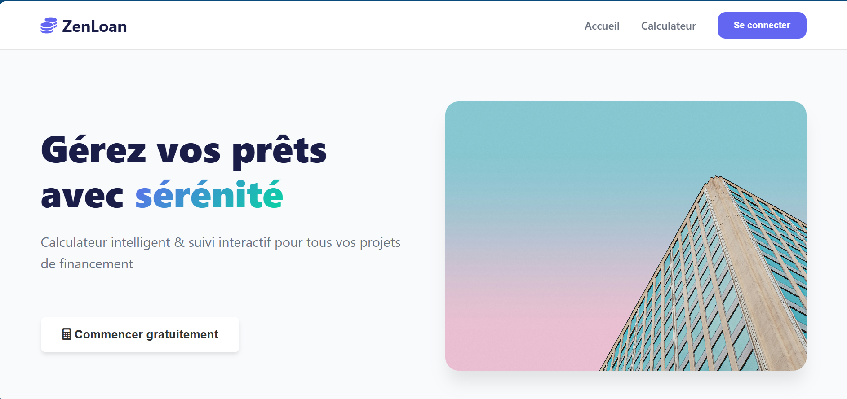
III. 1.User Interface (1/3)
This image shows the homepage's initial
interface featuring the slogan
'MANAGE YOUR LOANS WITH SERENITY.’
It includes navigation buttons for Home,
Loan Calculator, and
Login – indicating user account
functionality.
The prominent 'Start Free' button
at the bottom suggests a free
trial period is available for users.

Slide 7
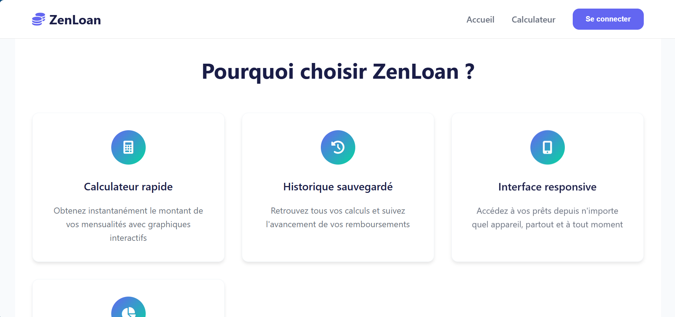
III.2.User Interface (2/3)
"Why Choose ZenLoan?" Section Highlights three core functionalities:
1) Fast Calculator delivering instant loan
estimates with interactive charts,
2) Saved History enabling users
to track repayment progress.
3) Responsive Interface ensuring
cross-device accessibility.
This value proposition reinforces
reliability through visual feature
breakdown.

Slide 8
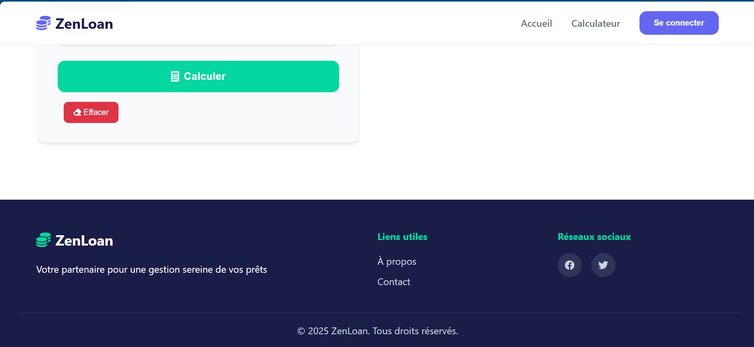
III.3.User Interface (3/3)
Website Footer
Features ZenLoan's branding with
the tagline "Your partner for serene
loan management." Includes essential
utility links (About/Contact),
social media integration, and copyright notice.
Provides secondary navigation while
reinforcing brand identity through
minimalist design.

Slide 9
IV.HTML Structure
Doctype & Language: <!DOCTYPE html>, language set to French (lang="fr").
Head: Metadata (charset, viewport), page title, CSS and icon links.
Body:
Header/Nav: Fixed top menu with logo, links, and login button.
Hero Section: Main welcome message, subtitle, call-to-action button,
and image.
Features Section: Grid of feature cards with icons and descriptions.
Calculator Section: Form inputs for loan details and result display.
Footer: Contact info, social links, legal mentions.
Scripts: JavaScript for loan calculation and interactivity.

Slide 10
V.CSS Styling
Color Palette: We used blue as the main color (instead of green), with light gray, white, and dark blue for contrast. → The goal is to create a modern and calm interface.
Font: Font used: Arial Narrow, in bold for all text. → Better readability and professional appearance.
Layout: Used Flexbox to center elements vertically and horizontally. → The form is well-aligned at the center of the page.
Responsive Design: Thanks to media queries, the site adapts to phones and tablets. → The layout stays smooth on all screen sizes.
CSS Effects:
Button hover effects (color change)
Box shadows to add depth
Rounded corners

Slide 11
VI.1.JavaScript Features (1/2)
Main JavaScript Features
The JavaScript code runs when the user clicks the "Calculate" button.
It collects the input values (amount, interest rate, duration).
It performs a dynamic calculation of the monthly payment.
The result is displayed instantly without reloading the page.

Slide 12
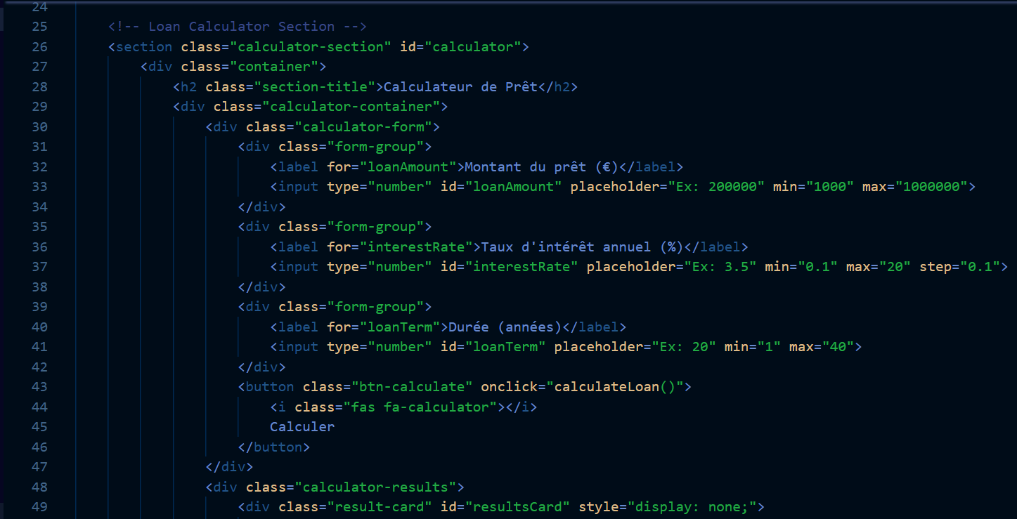
VI.2.JavaScript Features (2/2)
Gets the input values from the user
Calculates the monthly payment using a loan formula
Displays the result in the HTML

Slide 13
VII.Challenges and Solutions
CSS alignment issue: some elements were not
displaying properly on the page. → Solution: used Flexbox to better organize layout blocks.
Incorrect JavaScript calculation: the results were
sometimes inaccurate. → Solution: reviewed and fixed the calculation formulas and syntax.
Mobile display problem: the layout was not mobile-friendly. → Solution: added media queries to make the site responsive.
Learning outcome: gained a better understanding
of how HTML, CSS, and JS work together.

Slide 14
Final Result
The loan calculator is now fully functional.
Users can enter the loan amount, interest rate, and loan duration.
The website automatically displays the monthly payment.
The interface is clean, simple, and user-friendly.
The design was enhanced with CSS for a better user experience.
JavaScript works properly to perform real-time calculations.

Slide 15
Conclusion and Future Improvements
This project allowed us to apply HTML, CSS, and JavaScript in a practical way.
We learned how to build a functional user interface and manage dynamic interactions using JavaScript.
Despite some technical challenges, we successfully achieved our objectives.
In the future, we could improve the project by adding:
A feature to generate a loan amortization table
A more responsive and professional design
The ability to save calculations

Slide 16
Thank for attention !!!
• Your questions are welcome
• Thanks to the teacher and classmates

